Slide 1
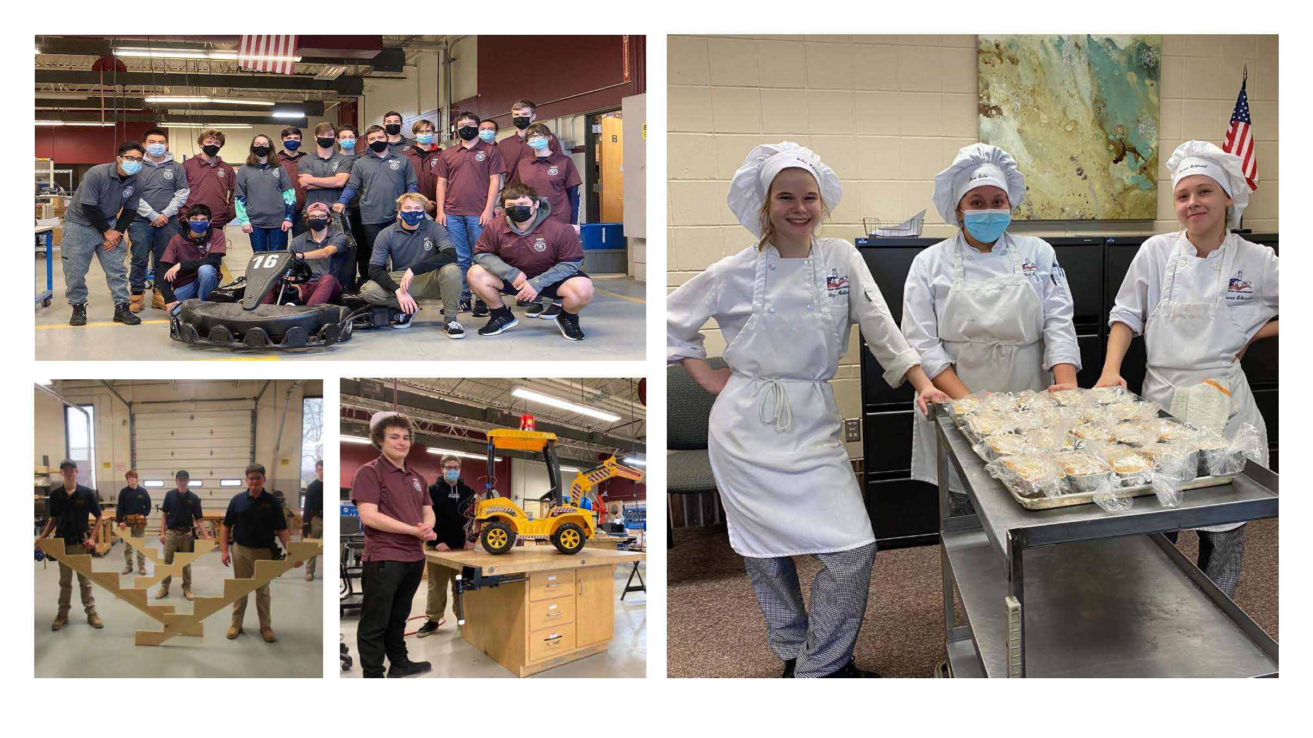
2022-2023 Proposed General Fund Budget
Frank Ayata, Business Manager
March 1, 2022

Slide 2
General Fund & Lease Rental
Budget-to-Budget
Table A | 2022-23 | 2021-22 | $ | %
General Fund* | $10,933,404 | $ 10,604,025 | $329,379 | 3.11%
Lease Rental | $ 1,462,444 | $ 1,467,844 | $ (5,400) | -0.37%
Total Expenditures | $12,395,847 | $12,071,869 | $323,978 | 2.68%

Slide 3
SUMMARY OF BUDGET-TO-BUDGET CHANGE:
DESCRIPTION | $ CHANGE
Salaries & Wages | $ 129,282
Retirement | 62,997
Health insurance | 77,490
Contractual & other statutory benefits | 18,364
Purchased services, supplies, equipment & other | 35,845
Total General Fund | $329,379
Lease Rental | -5,400
Total Budget-to-Budget | $323,978
*ESSER Grant Excluded

Slide 4
Receipts from Members
 | 2022-2023 | 2021-2022 | $ Change | % Change
General Fund | $ 8,737,165 | $ 8,612,150 | $ 125,015 | 1.45%
Lease Rental | $ 1,462,444 | $ 1,467,844 | $ -5,400 | -0.37%
Total | $ 10,199,609 | $ 10,079,994 | $ 119,615 | 1.19%

Slide 5
Other Revenues
 | 2022-2023 | 2021-2022 | $ Change
Other Local Revenues | $ 94,700 | $ 85,900 | $ 8,800
State Revenues | $1,807,230 | $ 1,661,800 | $ 145,430
Federal Revenues | $ 294,528 *ESSER Grant of $325,688 (Combined $620,216) | $ 268,000 | $ 26,528

Slide 6

Capital Reserve Fund
Funded at discretion of Executive Council using unspent current year budget.
  Proposed funding = $100,000
  CRF can be used for capital repairs, maintenance to facilities & program equipment
  Program equipment- Salon Styling Chairs,
  School Office Phones

Slide 7
Other Budgets
Adult Education $156,699 vs. $153,685
  Fall & Spring Adult Evening Programs
  Customized Industry Training
Production Fund $388,304 vs. $322,315
  Live work by students: Aspirations, Automotive, Salon Extreme & Student Built Modular House
  Student workbooks, certifications, field trips, and tool kits
  Summer Career Exploration

Slide 8

Other Budgets
Proprietary Fund
$244,711 vs. $239,754
Li’l Bucks Partners in Learning
Fiduciary: Student Activities Fund $35,963 vs. $34,964
Skills USA
HOSA
FFA
PBA
Educational programs for toddlers and preschool children

Slide 9

Questions?
Next Steps:
  Update assumptions
  Communicate with member district Superintendents, Business Administrators, and community
  Board action

