Slide 1
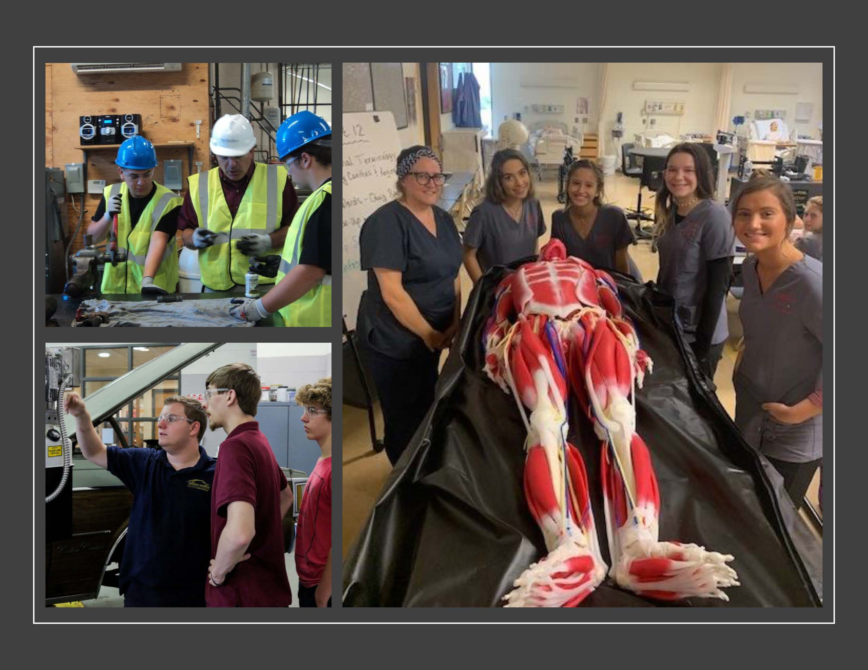
2020/2021
Proposed
General Fund Budget
Middle Bucks Institute of Technology
February 10, 2020

Slide 2
General Fund & Lease Rental
Budget-to-Budget
November 11, 2019
 | 2020/21 | 2019/20 | $ | %
General Fund | $10,930,138 | $ 10,367,519 | $ 562,619 | 5.43%
Lease Rental | 1,467,796 | 1,463,196 | 4,600 | 0.31%
Total Expenditures | $12,397,934 | $11,830,715 | $ 567,219 | 4.80%

Slide 3
General Fund & Lease Rental
Budget-to-Budget
February 10, 2020
 | 2020/21 | 2019/20 | $ | %
General Fund | $10,587,514 | $ 10,367,518 | $219,996 | 2.12%
Lease Rental | 1,467,796 | 1,463,196 | 4,600 | 0.31%
Total Expenditures | $12,055,310 | $11,830,714 | $224,596 | 1.90%

Slide 4
SUMMARY OF BUDGET-TO-BUDGET CHANGE:
DESCRIPTION | $ CHANGE | % CHANGE
Salaries & Wages | $ 37,767 | 0.36%
Retirement | 24,217 | 0.23%
Health insurance | 102,729 | 0.99%
Contractual & other statutory benefits | 6,761 | 0.06%
Purchased services, supplies, equipment & other | 48,522 | 0.47%
Total General Fund | $219,996 | 2.12%
Lease Rental | 4,600 | 0.31%
Total Budget-to-Budget | $224,596 | 1.90%

Slide 5
Receipts from Members
 | 2020/2021 | 2019/2020 | $ Change | % Change
General Fund | $ 8,595,054 | $ 8,192,518 | $ 402,536 | 4.91%
Lease Rental | 1,467,796 | 1,463,196 | 4,600 | 0.31%
Total | $10,062,850 | $ 9,655,714 | $ 407,136 | 4.22%

Slide 6
Other revenue / transfers / fund balance
 | 2019/2020 | 2019/2020 | $ Change | % Change
Other Local | $ 91,100 | $ 90,500 | $ 600 | 0.00%
State | $1,614,760 | $1,556,500 | $ 58,260 | 0.56%
Federal | $ 286,600 | $ 283,000 | $ 3,600 | 0.03%
BMCSHCC/ DVHT | $ - 0 - | $ 245,000 | $(245,000) | (2.36%)
Total | $1,992,460 | $2,175,000 | $(182,540) | (1.76%)

Slide 7
Capital Reserve Fund
Funded at discretion of Executive Council using unspent current year budget.
  Proposed funding = $100,000
  CRF can be used for capital repairs & maintenance to facilities and for program equipment
  Concrete repairs
  Roof replacement section D
  Program equipment

Slide 8
Other budgets
Adult Education $155,702 vs. $172,880
  Fall & spring adult evening programs
  Customized industry training
Production Fund $326,026 vs. $296,123
  Live work by students: Aspirations, Automotive, Salon Extreme & Student Built Modular House
  Student workbooks, certifications, field trips, and tool kits
  Summer Career Exploration

Slide 9
Other budgets
Proprietary Fund
  Li’l Bucks Preschool $250,452 vs. $249,671
  Educational programs for toddlers and preschool children
Fiduciary
Student Activities Fund
  Skills USA
  HOSA
  FFA
  PBA

Slide 10

Questions?
Next Steps:
  Update assumptions
  Present at March 9, 2020 meeting
  Board action

