Slide 1
2018/2019
Proposed General Fund & Other Budgets
Middle Bucks Institute of Technology
March 12, 2018

Slide 2
General Fund & Lease Rental
Budget-to-Budget
 | 2018/19 | 2017/18 | $ | %
General Fund | $9,825,529 | $9,598,974 | $226,555 | 2.36
Lease Rental | $1,461,996 | $1,465,996 | -$4,000 | -0.27%
Total Expenditures | $11,287,525 | $11,064,970 | $222,555 | 2.01%

Slide 3
Goal & Assumptions:
GOAL - To be at or below Act 1 Index of 2.4%
  ASSUMPTIONS:
Teachers’ salaries per MBEA contract
  Three Members are in or will be in status quo at July 1, 2018
All other salaries and wages using 2% increase
Health insurance using second look
  BMCS provides three looks at renewal
  Obtain quotation from alternative to BMCS
Retirement employer certified contribution rate = 33.43%
Tuition reimbursement recorded to Function 2200 per PDE

Slide 4
SUMMARY OF BUDGET-TO-BUDGET CHANGE:
DESCRIPTION | $ CHANGE | % CHANGE
Teacher’s Salaries | $93,872 | 0.98%
Admin & support staff salaries & wages | 34,151 | 0.37%
Retirement | 82,911 | 0.86%
Health insurance | 80,893 | 0.84%
Contractual & other statutory benefits | ( 6,455) | (0.06%)
Purchased services, supplies, equipment & other | (58,817) | (0.53%)
Total General Fund | $226,555 | 2.36%
Lease Rental | (4,000) | (0.27)%
Total Budget-to-Budget | $222,555 | 2.01%

Slide 5
Receipts from Members
 | 2018/2019 | 2017/2018 | $ Change | % Change
General fund | $8,045,829 | $7,853,674 | $192,155 | 2.45%
Lease Rental | $1,461,996 | $1,465,996 | -$4,000 | -0.27%
Total | $9,507,825 | $9,319,670 | $188,155 | 2.02%

Slide 6
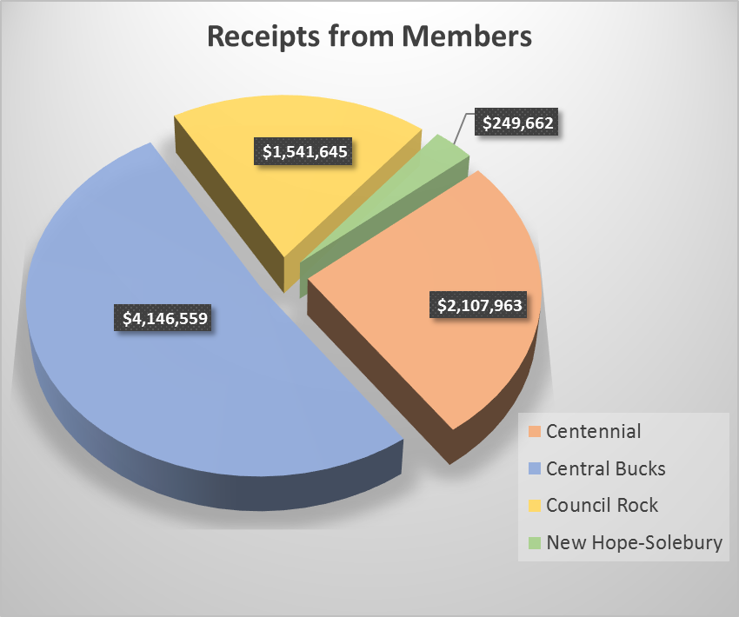

Slide 7
Other revenue / transfers / fund balance
 | 2018/2019 | 2017/2018 | $ Change | % Change
Other local | $ 90,500 | $ 84,300 | $ 6,200 | 0.06%
State | $1,422,200 | $1,376,000 | $ 46,200 | 0.48%
Federal | $ 267,000 | $ 265,000 | $ 2,000 | 0.02%
Fund balance/other | $ -0- | $ 20,000 | $( 20,000) | (100.0%)
Total | $1,779,700 | $1,745,300 | $ 31,400 | 0.33%

Slide 8
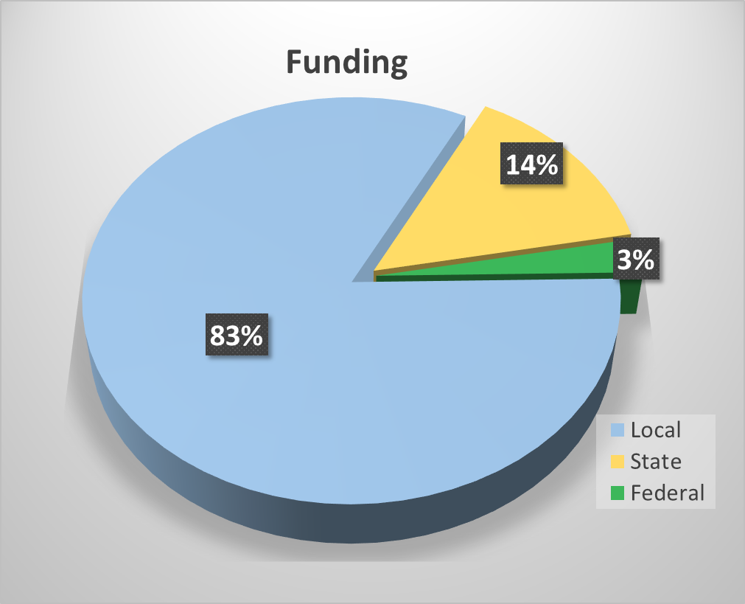

Slide 9
Other Budgets:
Capital Reserve Fund
Funded at discretion of Executive Council using unspent current year budget. Proposed transfer $100,000
Funds can be used for acquisition of program equipment, capital repairs and maintenance to facilities.
  Carryover items – Contribution for traffic signal and digital road sign
  Campus lighting, concrete repairs & plumbing
  HVAC RTUs & control system
  Program equipment needs:
    Automotive / Culinary Arts / Engineering / Multimedia
  Room & Storage Area Renovations
  Shop floors

Slide 10
Other Budgets:
Adult Education $181,937 vs. $163,868
  Fall & Spring Adult Evening Programs
  Customized Industry Training
Production Fund $290,756 vs. $295,973
  Live work by students: Aspirations, Automotive, Salon Extreme, Plant Sale & Student Built Modular House
  Student workbooks, Cosmetology kits & field trips
  Summer Career Exploration Program

Slide 11
Other Budgets:
Proprietary Fund
  Li’l Bucks Preschool $231,358 vs. $209,240
  Educational programs for toddlers and preschool children
Fiduciary
Student Activities Fund
  Skills USA
  Future Health Professionals – HOSA
  Future Farmers of America – FFA
  Pennsylvania Builders Association - PBA

Slide 12
Questions?
Next Step:
  Final revisions
  Board Action – April 9, 2018

